Slide 1
Bounty Based Federated Learning of Neural Networks
CSCI 5673
Prashanth Thipparthi

Slide 2
Problem Statement
Federated Learning is a distributed machine learning approach which enables model training on a large corpus of decentralised data
How can we reward the device which contributes more to the learning process of the model ?
This project aims to reward the device which contributes more data towards the learning of the central model using the blockchain.
Experimental project to bring together both the distributed technologies.

Slide 3
Related work
Federated learning: Strategies for improving communication efficiency[1]: Federated learning was initially proposed in this paper. The paper proposes to mitigate the issue of ownership and privacy of proprietary machine learning data.where an owner sends the training model to users who train on their local data and send back only the updated weights of the model.
Trustless machine learning contracts;evaluating and exchanging machine learning models on the ethereum blockchain[2]: This paper proposed an Ethereum blockchain implementation of machine learning to reward users for producing trained models for organizers.

Slide 4
White papers and open source projects
Ocean protocol
PySyft
PyGrid

Slide 5
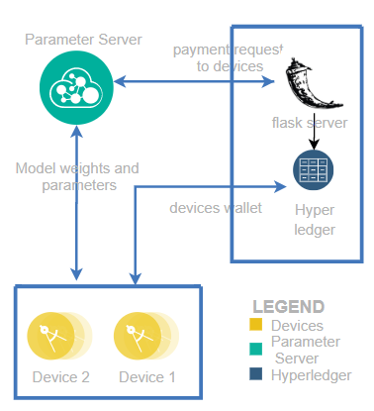
Architecture:

Slide 6
Tech stack:
Python
PySyft
PyTorch
Flask
Ethereum
Ganache

Slide 7

Dataset, Model:
Dataset containing surnames of people of different origin
https://download.pytorch.org/tutorial/data.zip
After training we predict surname's language of origin
Model:
5 layer model with 128 neurons.
1 output layer
Negative log likelihood loss (NLL loss) function

Slide 8
Short Demo

Slide 9
How it works ?
In the experiment, data is randomly splitted across the devices before the first round.
Central server creates a PyTorch hook
Distributes it to the clients.
When the round starts RPC calls are made and the hook is used to perform the required operations on the clients.
Weights from all the available hooks are aggregated at the end of the round.
Payment request is made to the flask server which can execute the transaction on the blockchain.
Start workers by running : python run_websocket_server --host <device_ip> --port <port_number> --id <alice>

Slide 10
The Problem: Payment criteria to the users ?
How much is my data worth?
How to fairly allocate the revenue generated by a ML model to the data contributors ?

Slide 11
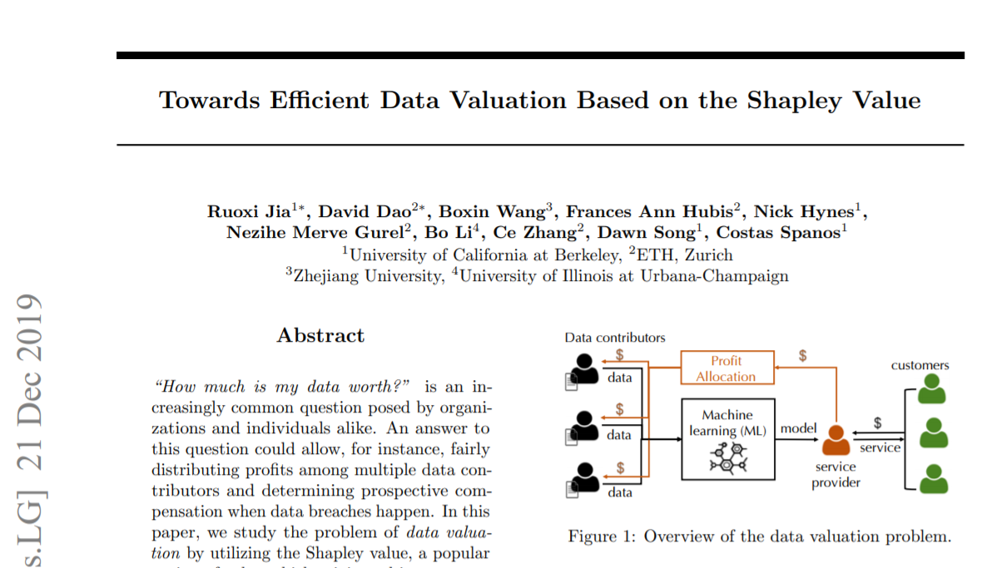
Shapley Values from Co-operative Game theory

Slide 12
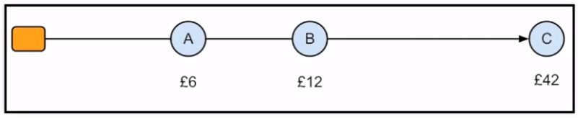
Shapley Values: Example
Amy, Bob, Rob share a taxi.
It costs Amy $6 to get home
It costs Bob $12 to get home
It costs Rob $42 to get home

Slide 13
Shapley Values: Example (Cont)
Contributions:
S V(S)
{A} 6
{B} 12
{C} 42
{A,B} 12
{A,C} 42
{B,C} 42
{A, B,C} 42

Slide 14
Shapley Values: Example (Cont)
Shapley value calculation:
π Amy Bob Rob
(A,B,C) 6 6 30
(A,C,B) 6 0 36
(B,A,C) 0 12 30
(B,C,A) 0 12 30
(C,A,B) 0 0 42
(C,B,A) 0 0 42
Φ 2 5 32

Slide 15
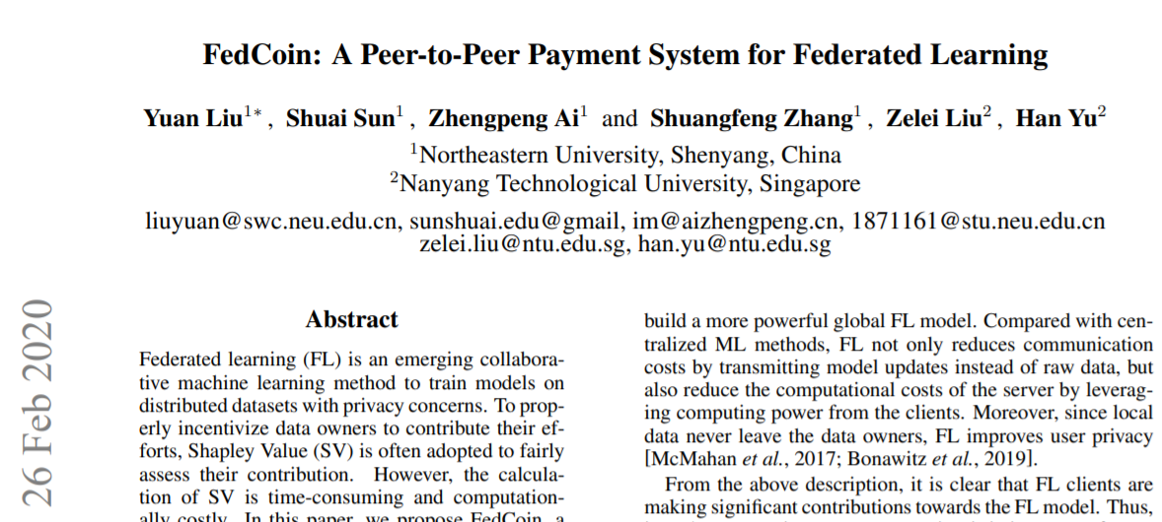
Architecture to calculate Shapley Values in Blockchain

Slide 16
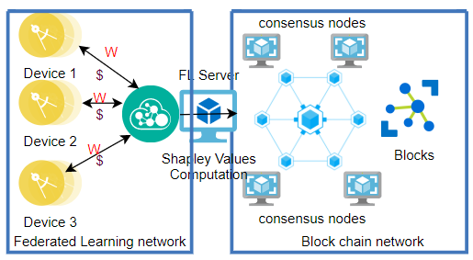
Proposed Architecture

Slide 17
Proposed Architecture (Cont)
There are two networks of participants in the system:
FL network
peer-to-peer blockchain network
A FL model requester or FL training task requester refers to the entities who need to train an FL network and with a budget of V . In the FL network, there is a centralized server, FL server, in coordinating the executing of model training and receiving payment V from FL model requester.
The distributed data owners, called as FL clients, participate in a collaborative training task and receive a payment V.

Slide 18
Proposed Architecture (Cont)
The FL server plays three roles.
Firstly, it publishes a training task to FL clients with price TrainPrice
Secondly, it aggregates local updates through a secure aggregation protocol and earns a computation payment (ComPrice).
Thirdly, it transfer a processing fee SapPrice to the blockchain network to enlist its members help in calculating the FL model.

Slide 19
Proposed Architecture (Cont)
The total payment of the task (TrainPrice+ComPrice+SapPrice) should be not greater than V in order to sustain payment balance without relying on external transfer of values into this system.
After each global model update, the FL server publishes a task to calculate the contribution by each FL client. The consensus nodes in blockchain network then collaboratively calculate SVs, and the block winner receives a payment of SapPrice.
The winner then divides ComPrice+TrainPrice to FL clients according to their respective SVs by creating transactions in the blockchain

Slide 20
Open Source Projects:
Ocean Protocol:
Connecting Data haves with AI haves.
A Decentralized Data Exchange Protocol to Unlock Data for AI.
Goal of Ocean Protocol is kickstarting a Data Economy by breaking down data silos and equalizing access to data for all.
Transactions on the network happens with the "Ocean coin"

Slide 21
Open Source Projects:
PyGrid:
PyGrid is a peer-to-peer network of data owners and data scientists who can collectively train AI models using PySyft.
On PyGrid users can search for a dataset which is available on the network, if users choose to share it.
To preserve the privacy of data, users can choose various levels of noise to be added to your data while sharing.
Other projects: TensorFlow Federated, PyTorch distributed.

Slide 22
Future Work and Conclusions.
Reduce the computational cost of data evaluation by enhancing Shapley value calculation by utilising the approximation algorithms.
Exploring data sharing protocols on a decentralised AI network so that AI can be democratised.
From the above related research work and experiments, we can conclude that there is a good feasibility for the above project to implemented in a full scale with added enhancements of data valuation.

Slide 23
Its is a combined project for two courses by single student.
Courses are :
CSCI 5922
CSCI 5673

Slide 24
Thank you !

